Slide 1

Building an ESG Knowledge Graph
Working Group 4: Priya Singh, Christopher Unkart, Rainer Gogel

Slide 2
Content
Extract data from XBRL
Ontologies
Knowledge Graph Construction
Add data to Knowledge Graph
External data from Wikidata and DBpedia
Text embeddings
Knowledge Graph Bot
Knowledge Graph Queries

Slide 3
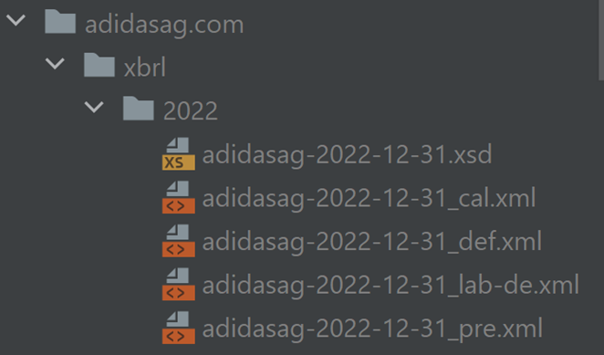
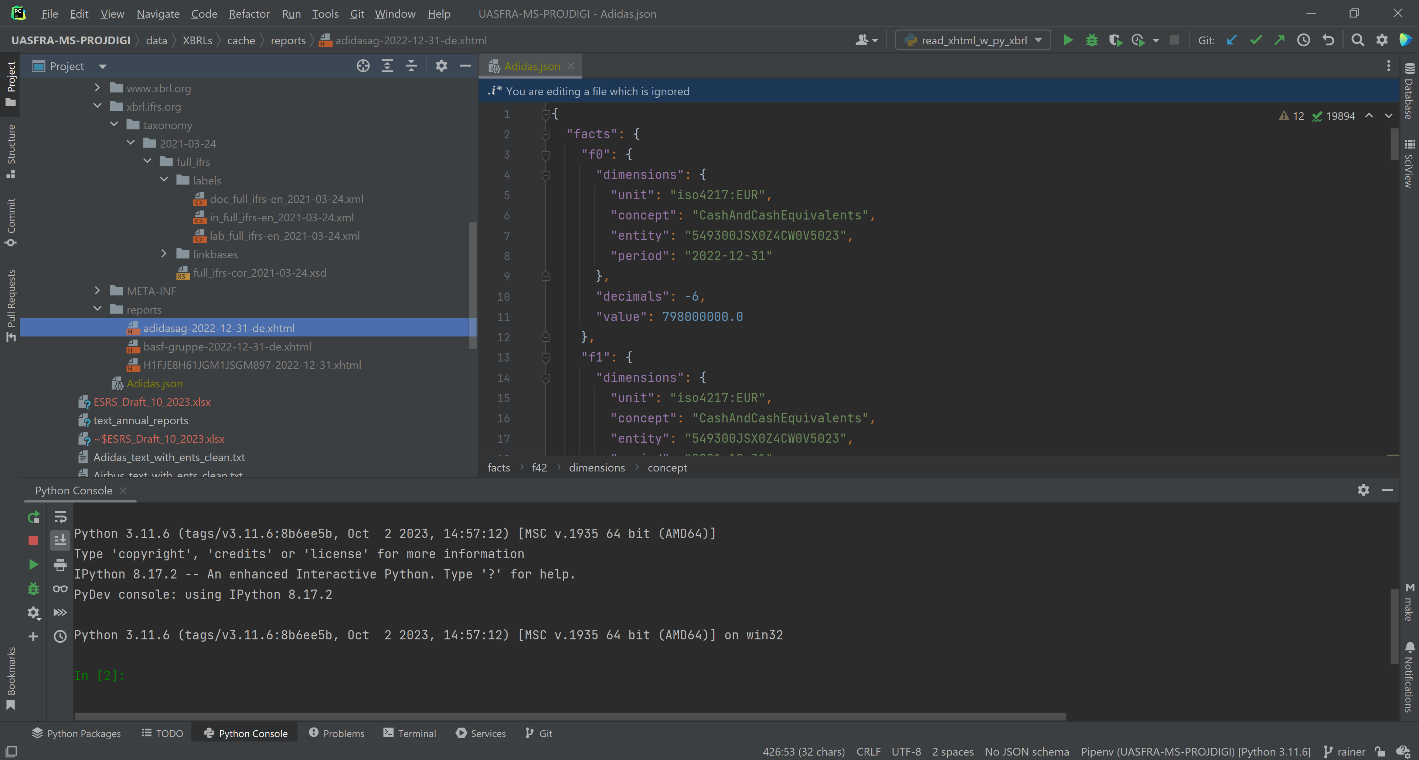
Extract data from XBRL
ESRS: XBRL Delivery Requirement
ESEF Taxonomy Schema
JSON
1. extract
and
calculate:
Instance Document
Extract data from XBRL into standardized JSON-Files
Notes:
- We will not demonstrate this in a live demo as we already have done so in the first milestone

Slide 4

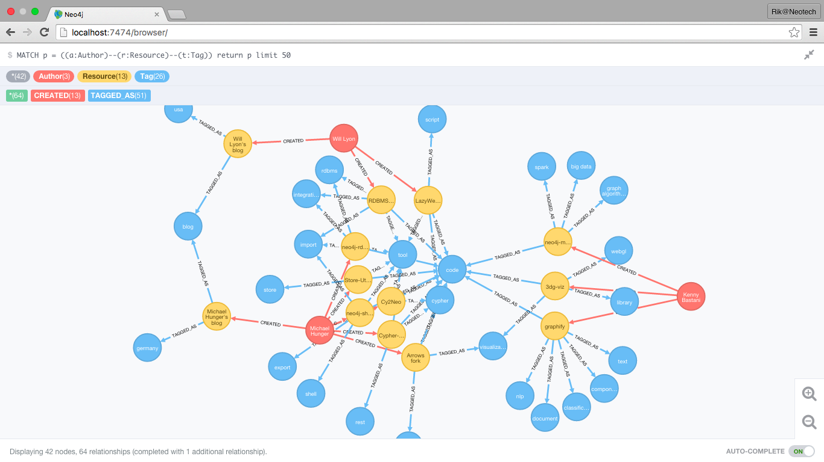
Extract data from XBRL
JSON
Knowledge Graph
2. populate
No ESG data available yet – we used sample data to populate the Knowledge Graph

Slide 5
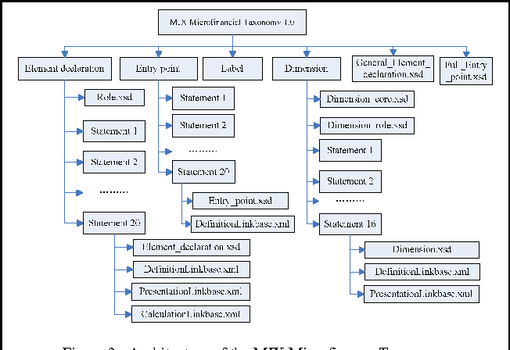
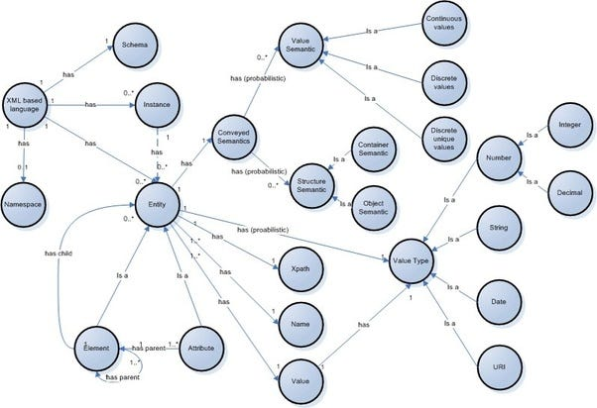
Ontologies
ESRS Taxonomy Schema
Ontology / Knowledge Graph
derive
Hierarchy
Concrete
Semantic Meaning
Relationships
Derive Ontology based on ESRS Taxonomy

Slide 6

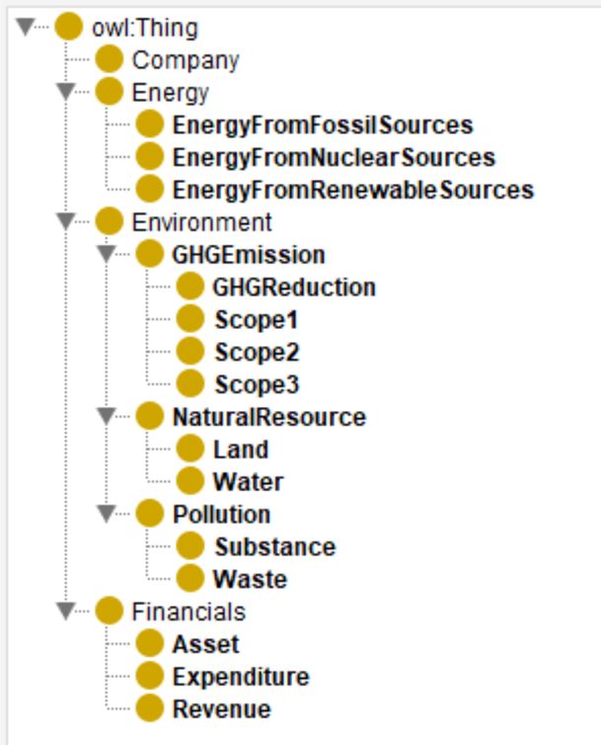
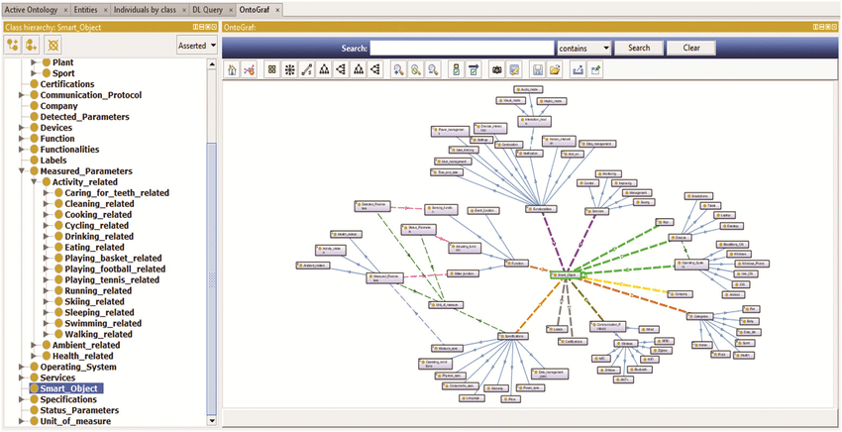
Ontologies
create
Created ontology for 21 exemplary data points with 16 Node labels

Slide 7
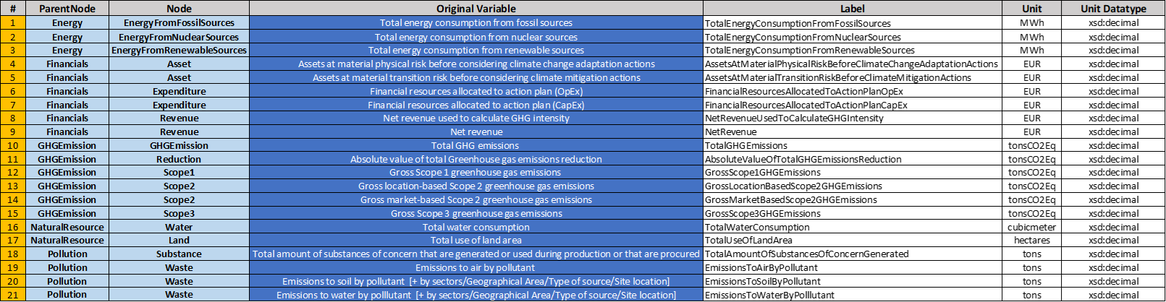
Ontologies
16 NODE LABELS:
SUBORDINATE
POSSIBLY
ALL DATAPOINTS
DATA FROM ALL ESRS-AREAS:
ESRS_E1: Climate Change
ESRS_E2: Pollution
ESRS_E3: Water and Marine Resources
ESRS_E4: Biodiversity and Ecosystems
ESRS_E5: Resource Use and Circular Economy
16 Node labels capable to subordinate ALL (>21) data points. Data from all E-Areas (E1-E5).
Notes:
- “>21” means possible ALL datapoints that need to be reported
- If some data points do not fit under the existing Nodes, no problem:
-> Just rewrite the ontology and do some adjustment as explained in the documentation

Slide 8
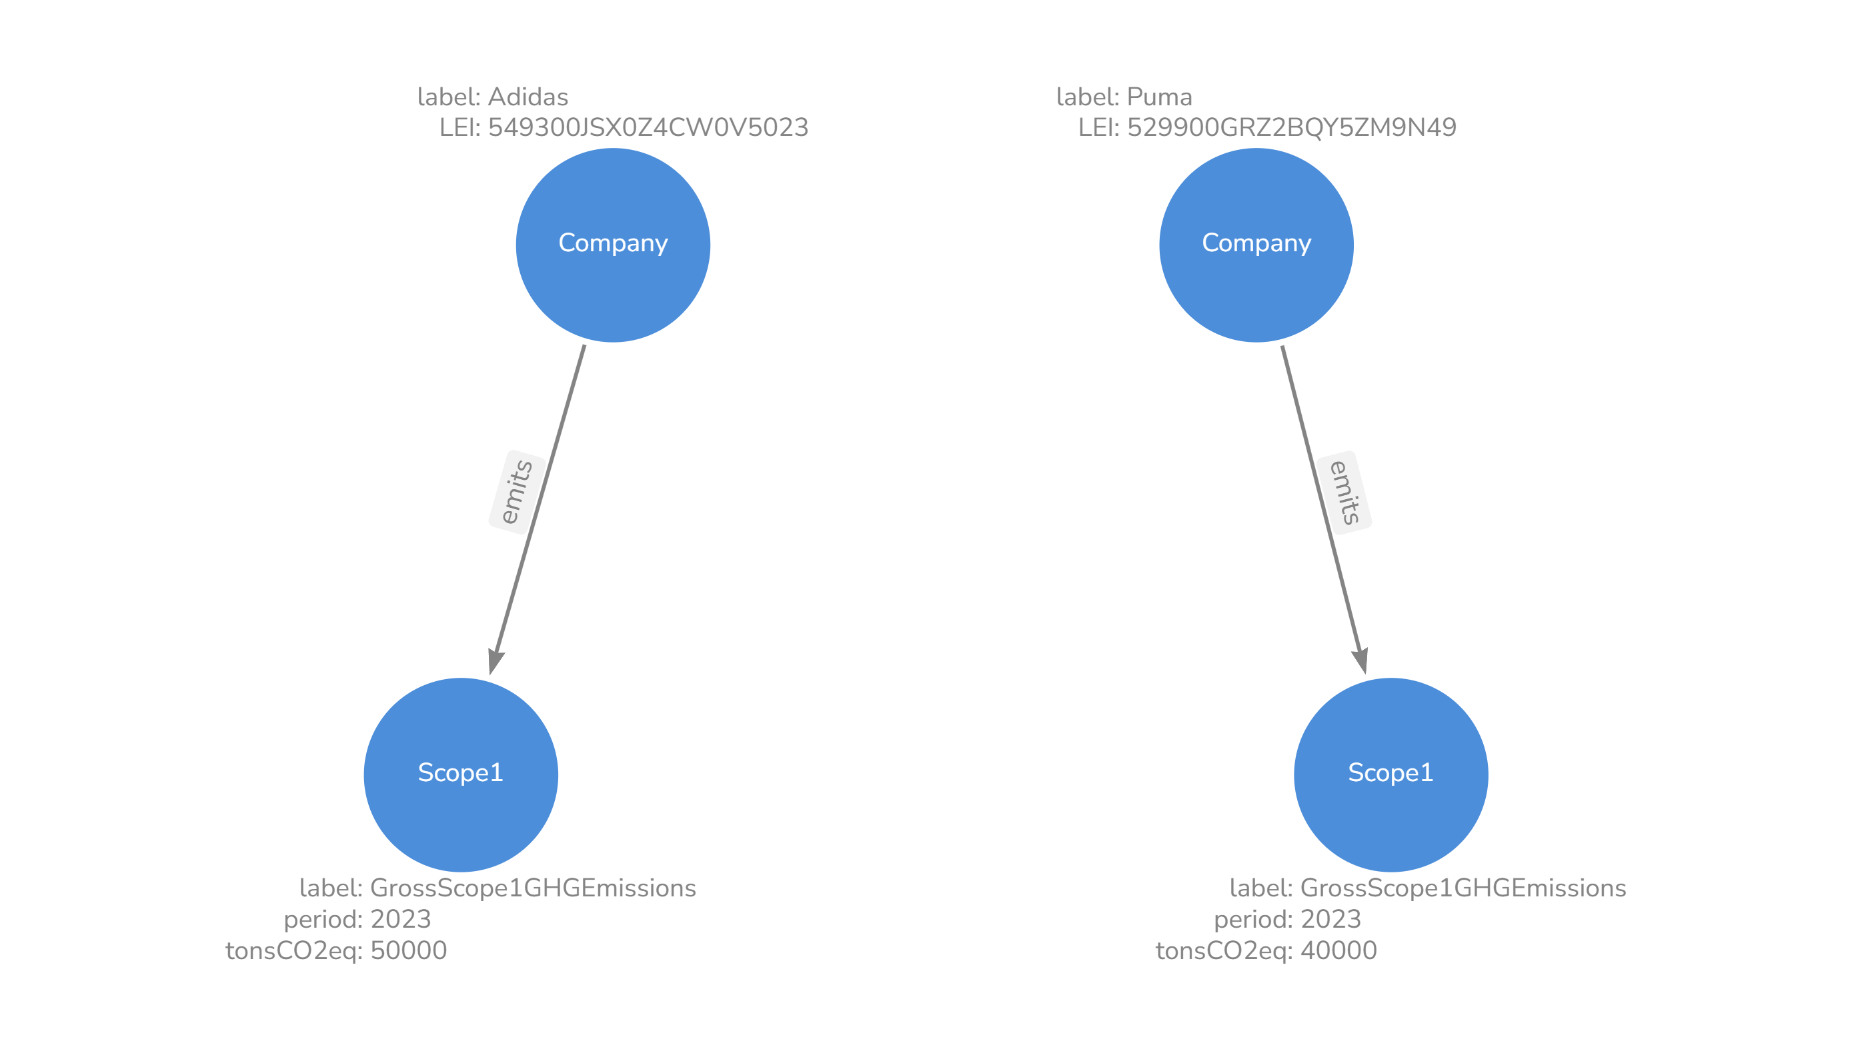
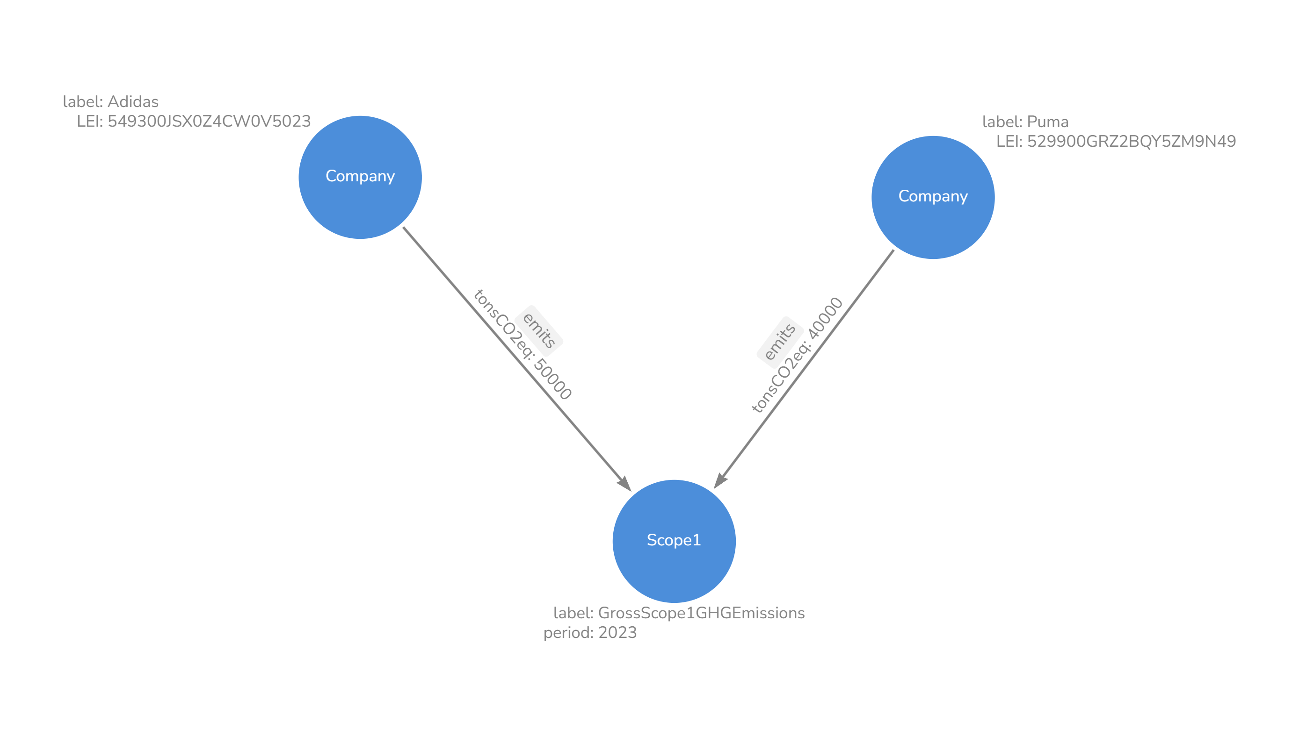


Ontologies
2
Scope1 Nodes
1
Scope1 Node
Data point values stored in RELATIONSHIP, not in NODE. Saves Nodes and memory.

Slide 9
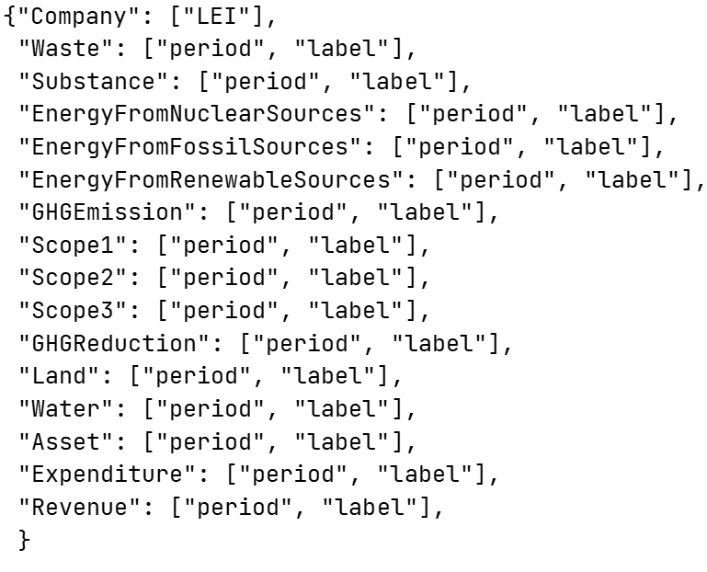
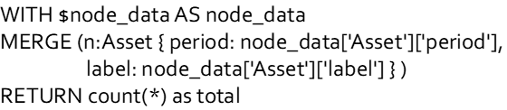

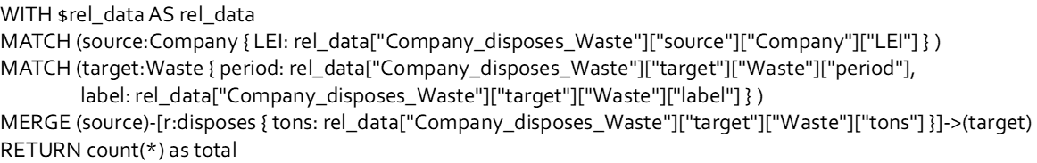
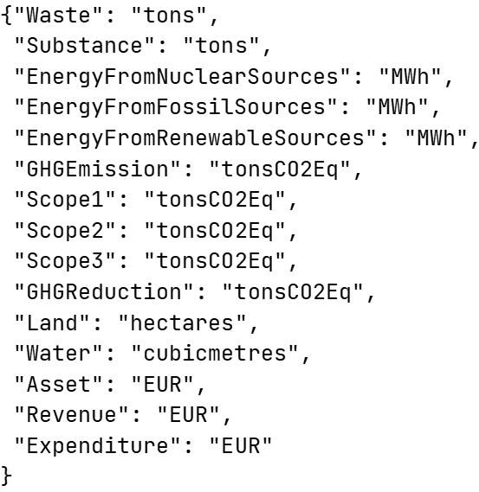
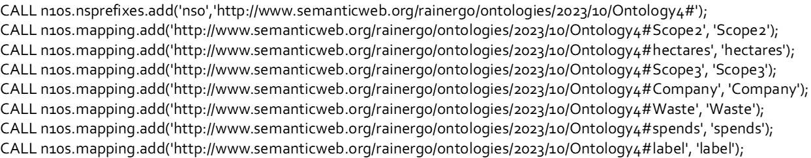
knowledge graph construction
unique_node_keys
node_query_templates
JSON-Data
Ontology
2
relation_query_templates
1
node_val_props
constraint_query_templates
3
namespace_query_templates
Ontology and inputs create query-templates that are used to import the JSON-data into NEO4J
Notes:
- Explain this in detail as described in the documentation

Slide 10


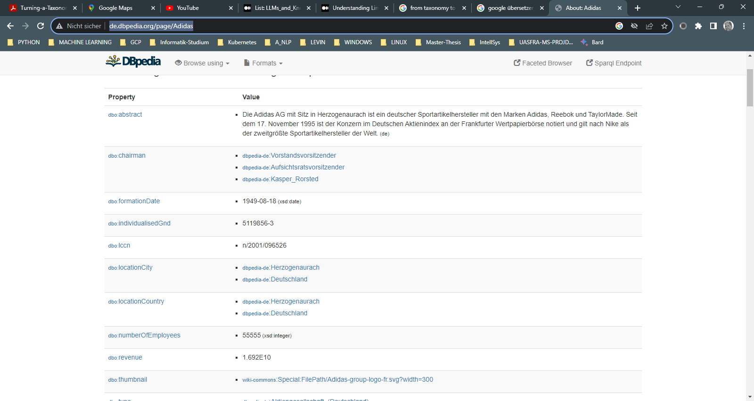
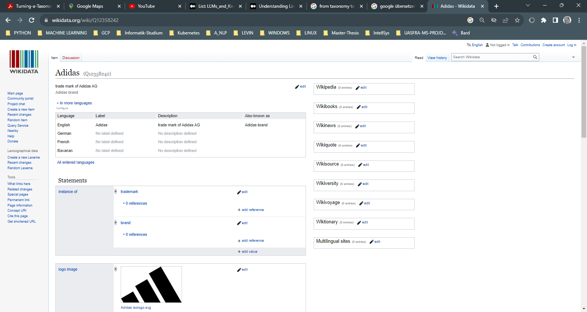

add data to knowledge graph
requests
DBpedia:
- abstract (“Company description”)
Wikidata:
- industries
- country
- ISIN
External data from Wikidata and DBpedia loaded into NEO4J via SPARQL requests over internet
Notes:
- Potentially show this with a real SPARQL query in: https://query.wikidata.org/

Slide 11

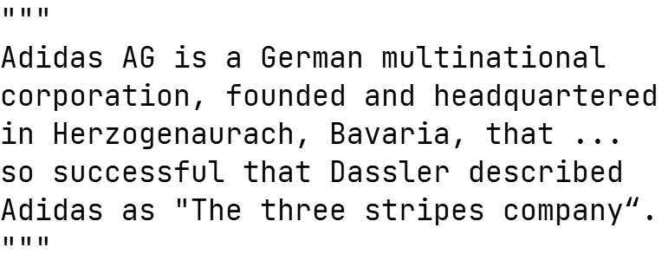
add data to knowledge graph
DBpedia:
- abstract (“Company description”)
1
2
Embedding of:
- abstract (“Company description”)
3
Add embedding of text to Knowledge Graph Node (“Company”) as property to later do similarity search
Notes:
- This enables similarity search of Nodes in respect to their property "abstract".
- This method currently is not used actively as the similarity between company descriptions (i.e. "abstracts") does not make sense in our opinion.
- But it could make sense to do similarity search in the future if other text properties of the ESG data need to be compared.

Slide 12
LIVE DEMO 1:
Create Knowledge Graph with data in NEO4J

Slide 13




knowledge graph bot
1: question
2: Cypher Query
4: answer
3: Cypher Response
Send text question to Knowledge Graph Bot to receive text answer
Notes:
- OpenAI API key required as described in the documentation

Slide 14
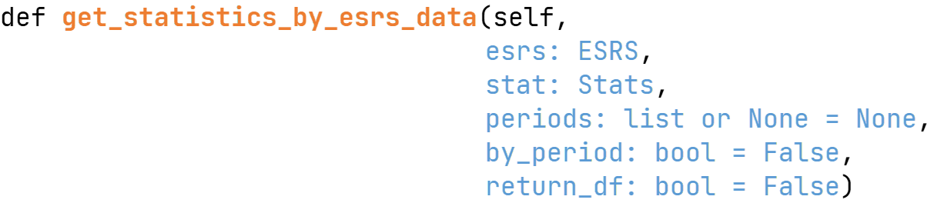
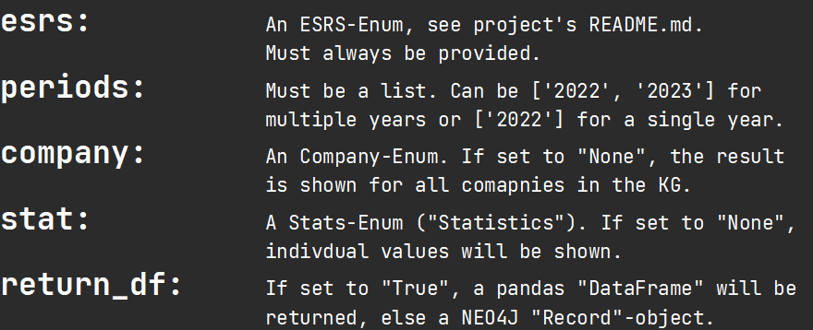
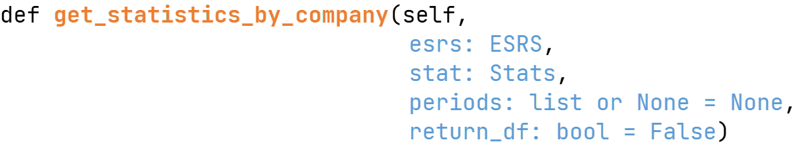
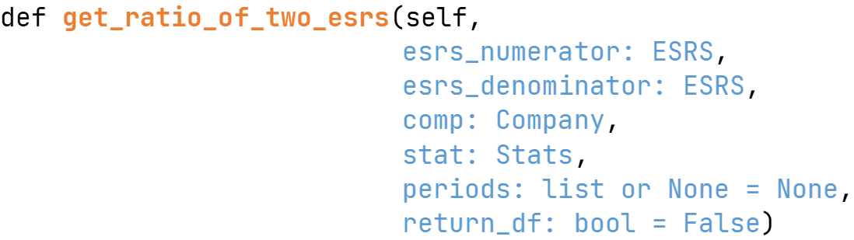
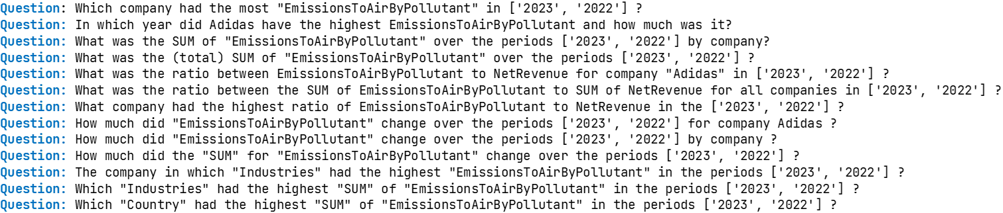
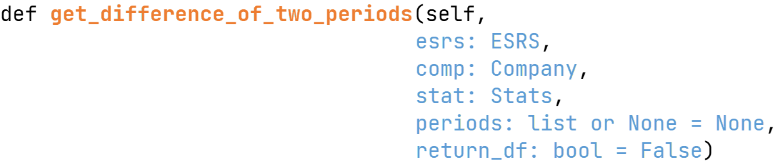
knowledge graph queries
6 Parameterizable Functions:
1
Parameters:
2
Parameterized functions allow for a wide range of different questions.
Notes:
- Only 4 functions are shown here, but there are actually 6 of them!

Slide 15
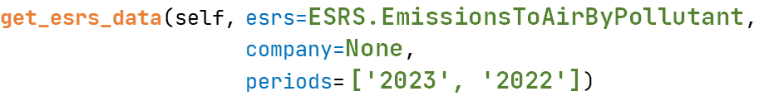
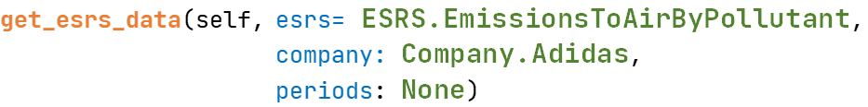
knowledge graph queries
Example:
Parameterizable Function:
QUESTION:
“Which company had the most EmissionsToAirByPollutant in ['2023', '2022’] ?”
QUESTION:
“In which year did Adidas have the highest EmissionsToAirByPollutant and how much was it ?”
Change in parameters will change question, answer and answer components.

Slide 16
LIVE DEMO 2:
Query Knowledge Graph

Slide 17
Thank you
for your attention !

